Slide 1
Image acquisition using sparse (pseudo)-random matrices
Piotr Indyk
MIT

Slide 2
Outline
Sparse recovery using sparse random matrices
Using sparse matrices for image acquisition

Slide 3
Sparse recovery (approximation theory, statistical model selection, information-based complexity, learning Fourier coeffs, linear sketching, finite rate of innovation, compressed sensing...)
Setup:
Data/signal in n-dimensional space : x
Goal: compress x into a “sketch” or “measurement” Ax ,
where A is a m x n matrix, m << n
Stable recovery: want to recover an “approximation” x* of x
Sparsity parameter k
Informally: want to recover largest k coordinates of x
Formally: l_{p}/l_{q} guarantee. I.e. want x* such that
||x*-x||_{p}≤ C(k) min_{x’} ||x’-x||_{q}
over all x’ that are k-sparse (at most k non-zero entries)
Want:
Good compression (small m=m(k,n))
Efficient algorithms for encoding and recovery
Useful for compressed sensing of signals, data stream algorithms, genetic experiment pooling etc etc….
A
=
Ax
x

Slide 4
Constructing matrix A
“Most” matrices A work
Dense matrices:
Compressed sensing
Sparse matrices:
Streaming algorithms
Coding theory (LDPC)
“Traditional” tradeoffs:
Sparse: computationally more efficient, explicit
Dense: shorter sketches, i.e. k log(n/k) [Candes-Romberg-Tao’04]
Recent results: efficient and measurement-optimal

Slide 5
Algorithms for Sparse Matrices
Sketching/streaming [Charikar-Chen-Colton’02, Estan-Varghese’03, Cormode-Muthukrishnan’04]
LDPC-like: [Xu-Hassibi’07, Indyk’08, Jafarpour-Xu-Hassibi-Calderbank’08]
L1 minimization: [Berinde-Gilbert-Indyk-Karloff-Strauss’08,Wang-Wainwright-Ramchandran’08]
Message passing: [Sarvotham-Baron-Baraniuk’06,’08, Lu-Montanari- Prabhakar’08, Akcakaya-Tarokh’11]
Matching pursuit*: [Indyk-Ruzic’08, Berinde-Indyk-Ruzic’08, Berinde-Indyk’09, Gilbert-Lu-Porat-Strauss’10]
Surveys:
A. Gilbert, P. Indyk, Proceedings of IEEE, June 2010
V. Cevher, P. Indyk, L. Carin, and R. Baraniuk. IEEE Signal Processing Magazine, 26, 2010.
* Near-linear time (or better), O(k log(n/k)) , stable recovery (l1/l1 guarantee)

Slide 6
dense vs. sparse
Restricted Isometry Property (RIP) [Candes-Tao’04]
Δ is k-sparse ⇒ ||Δ||₂≤ ||AΔ||₂ ≤ C ||Δ||₂
Holds w.h.p. for:
Random Gaussian/Bernoulli: m=O(k log (n/k))
Random Fourier: m=O(k log^{O(1)} n)
Consider m x n 0-1 matrices with d ones per column
Do they satisfy RIP ?
No, unless m=Ω(k²) [Chandar’07]
However, they can satisfy the following RIP-1 property [Berinde-Gilbert-Indyk-Karloff-Strauss’08]:
Δ is k-sparse ⇒ d (1-ε) ||Δ||₁≤ ||AΔ||₁ ≤ d||Δ||₁
Sufficient (and necessary) condition: the underlying graph is a ( k, d(1-ε/2) )-expander
(a random matrix with d=k log (n/k) and m=O(k log (n/k)/ε^2) is good w.h.p)
N(S)
d
S
m
n

Slide 7
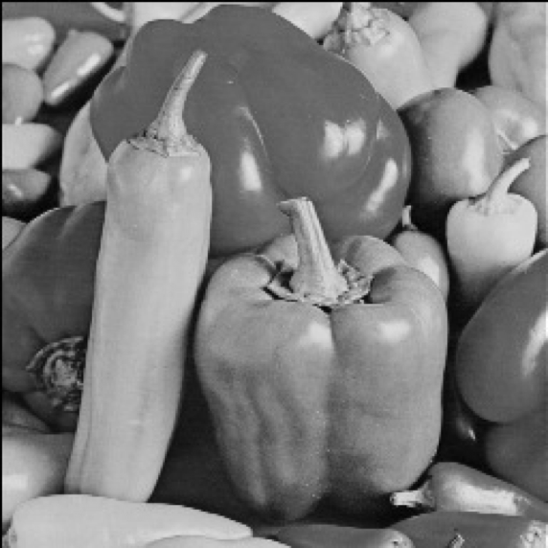
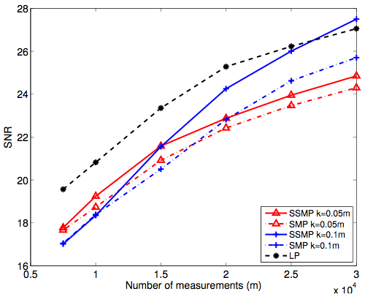
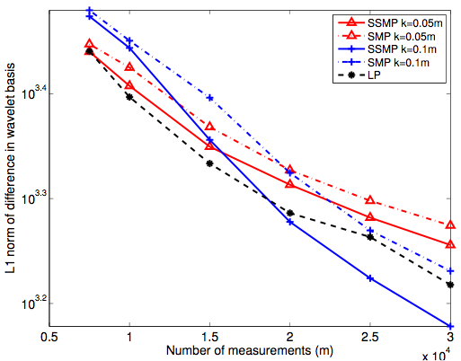
Experiments [Berinde-Indyk’09]
256x256
SSMP is ran with S=10000,T=20. SMP is ran for 100 iterations. Matrix sparsity is d=8.

Slide 8
Random sparse matrices for image acquisition
Implementable using random lens approach [R. Fergus, A. Torralba, W. T. Freeman’06]
Random design tricky to deal with
Alternative: make random matrices less random using “folding” [Gupta-Indyk-Price-Rachlin’11]

Slide 9
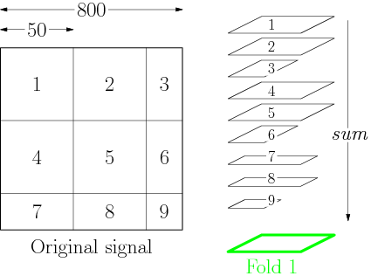
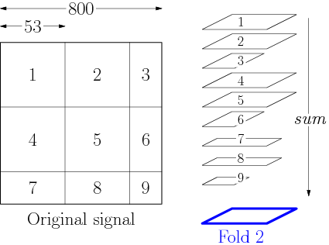
Folding
1 1 1 1
1 1 1 1
1 1 1 1
1 1 1
1 1 1
1 1 1

Slide 10
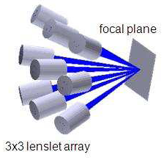
Architectures
Optically multiplexed imaging
Replicate d times
Split the beam
CMOS
[Uttam-Goodman-Neifeld-
Kim-John-Kim-Brady’09]

Slide 11
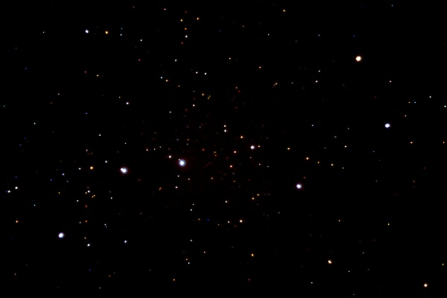
Application: star tracking

Slide 12
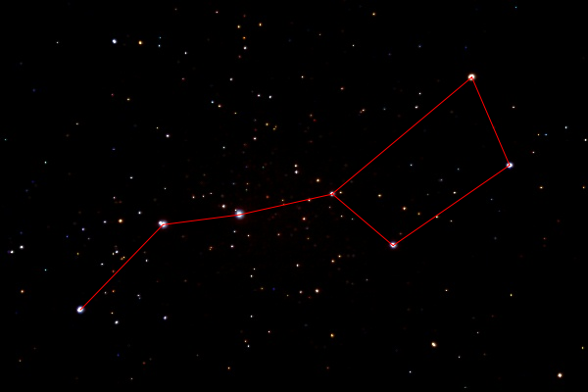
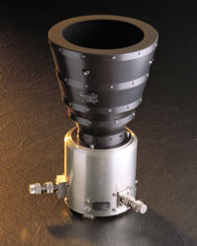
Application: star tracking
Star tracker
Find some/most stars
Lookup the database
Images are sparse ➔ compressive star tracker

Slide 13
How do we recover from folded measurements ?
Option I: generic approach
Use any algorithm to recover (most of) the stars
(if needed, “pretend” the matrix is random)
Lookup the database
Option II: Algorithm tailored to folded measurements of “geometric objects”
O(k log_{k}n) measurements and similar recovery time (under some assumptions)
Uses O(log_{k}n) folds

Slide 14
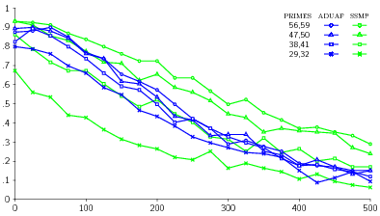
Results

Slide 15
Conclusions
Sparse recovery using sparse matrices
Natural architectures

Slide 16
APPENDIX

Slide 17
References
Survey:
A. Gilbert, P. Indyk, “Sparse recovery using sparse matrices”, Proceedings of IEEE, June 2010.
Courses:
“Streaming, sketching, and sub-linear space algorithms”, Fall’07
“Sub-linear algorithms” (with Ronitt Rubinfeld), Fall’10
Blogs:
Nuit blanche: nuit-blanche.blogspot.com/

Slide 18
Appendix

Slide 19
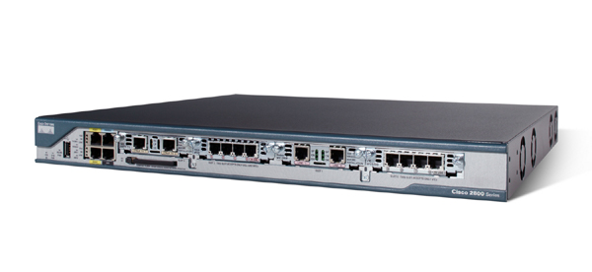
Application I: Monitoring Network Traffic Data Streams
Router routs packets
Where do they come from ?
Where do they go to ?
Ideally, would like to maintain a traffic
matrix x[.,.]
Easy to update: given a (src,dst) packet, increment x_{src,dst}
Requires way too much space!
(2³² x 2³² entries)
Need to compress x, increment easily
Using linear compression we can:
Maintain sketch Ax under increments to x, since
A(x+Δ) = Ax + AΔ
Recover x* from Ax
destination
source
x

Slide 20
l∞/l₁ implies l₁/l₁
Algorithm:
Assume we have x* s.t. ||x-x*||∞≤ C Err₁ /k.
Let vector x’ consist of k largest (in magnitude) elements of x*
Analysis
Let S (or S* ) be the set of k largest in magnitude coordinates of x (or x* )
Note that ||x*_{S}|| ≤ ||x*_{S*}||₁
We have
||x-x’||₁ ≤ ||x||₁ - ||x_{S*}||₁ + ||x_{S*}-x*_{S*}||₁
≤ ||x||₁ - ||x*_{S*}||₁ + 2||x_{S*}-x*_{S*}||₁
≤ ||x||₁ - ||x*_{S}||₁ + 2||x_{S*}-x*_{S*}||₁
≤ ||x||₁ - ||x_{S}||₁ + ||x*_{S}-x_{S}||₁ + 2||x_{S*}-x*_{S*}||₁
≤ Err + 3α/k * k
≤ (1+3α)Err

Slide 21
Application I: Monitoring Network Traffic Data Streams
Router routs packets
Where do they come from ?
Where do they go to ?
Ideally, would like to maintain a traffic
matrix x[.,.]
Easy to update: given a (src,dst) packet, increment x_{src,dst}
Requires way too much space!
(2³² x 2³² entries)
Need to compress x, increment easily
Using linear compression we can:
Maintain sketch Ax under increments to x, since
A(x+Δ) = Ax + AΔ
Recover x* from Ax
destination
source
x

Slide 22
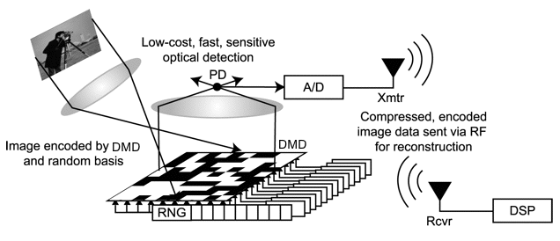
Applications, ctd.
Single pixel camera
[Wakin, Laska, Duarte, Baron, Sarvotham, Takhar, Kelly, Baraniuk’06]
Pooling Experiments [Kainkaryam, Woolf’08], [Hassibi et al’07], [Dai-Sheikh, Milenkovic, Baraniuk], [Shental-Amir-Zuk’09],[Erlich-Shental-Amir-Zuk’09]

Slide 23
Experiments
256x256
SSMP is ran with S=10000,T=20. SMP is ran for 100 iterations. Matrix sparsity is d=8.

Slide 24
SSMP: Running time
Algorithm:
x*=0
Repeat T times
For each i=1…n compute* z_{i} that achieves
D_{i}=min_{z} ||A(x*+ze_{i})-b||₁
and store D_{i} in a heap
Repeat S=O(k) times
Pick i,z that yield the best gain
Update x* = x*+ze_{i}
Recompute and store D_{i’} for all i’ such that
N(i) and N(i’) intersect
Sparsify x*
(set all but k largest entries of x* to 0)
Running time:
T [ n(d+log n) + k nd/m*d (d+log n)]
= T [ n(d+log n) + nd (d+log n)] = T [ nd (d+log n)]
A
_{i}
Ax-Ax*
x-x*
Notes:
color code copies ?
if Ax contains copies of k, then we can reverse this process. If we look at each coordinate on the left, and its neighbors, then we can perform a voting process
uses insights developed by l2/l1
Emphasize the algorithm works for *any* signals x

Slide 25
Prior and New Results
Paper | Rand. / Det. | Sketch length | Encode time | Column sparsity | Recovery time | Approx
Notes:
emphasize arbitrary signals

Slide 26
Results
Scale:
Excellent
Very Good
Good
Fair
Paper | R/D | Sketch length | Encode time | Column sparsity | Recovery time | Approx
[CCF’02], [CM’06] | R | k log n | n log n | log n | n log n | l2 / l2
 | R | k log^{c} n | n log^{c} n | log^{c} n | k log^{c} n | l2 / l2
[CM’04] | R | k log n | n log n | log n | n log n | l1 / l1
 | R | k log^{c} n | n log^{c} n | log^{c} n | k log^{c} n | l1 / l1
[CRT’04] [RV’05] | D | k log(n/k) | nk log(n/k) | k log(n/k) | n^{c} | l2 / l1
 | D | k log^{c} n | n log n | k log^{c} n | n^{c} | l2 / l1
[GSTV’06] [GSTV’07] | D | k log^{c} n | n log^{c} n | log^{c} n | k log^{c} n | l1 / l1
 | D | k log^{c} n | n log^{c} n | k log^{c} n | k² log^{c} n | l2 / l1
[BGIKS’08] | D | k log(n/k) | n log(n/k) | log(n/k) | n^{c} | l1 / l1
[GLR’08] | D | k logn^{logloglogn} | kn^{1-a} | n^{1-a} | n^{c} | l2 / l1
[NV’07], [DM’08], [NT’08], [BD’08], [GK’09], … | D | k log(n/k) | nk log(n/k) | k log(n/k) | nk log(n/k) * log | l2 / l1
 | D | k log^{c} n | n log n | k log^{c} n | n log n * log | l2 / l1
[IR’08], [BIR’08],[BI’09] | D | k log(n/k) | n log(n/k) | log(n/k) | n log(n/k)* log | l1 / l1
[GLSP’09] | R | k log(n/k) | n log^{c} n | log^{c} n | k log^{c} n | l2 / l1
Caveats: (1) most “dominated” results not shown (2) only results for general vectors x are displayed
Notes:
emphasize arbitrary signals

